Slide 1




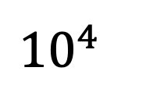
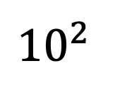
30
NPA
Ground-truth
20
Node size
10
0
0.2
0.4
$$τ$$
0.6
0.8
NPA
NPA without $k$-core
28x
$${10}^{4}$$
Running time (sec)
419x
929x
874x
$${10}^{2}$$
$$0$$
$$τ$$
0.2
0.4
0.6
0.8

Slide 2


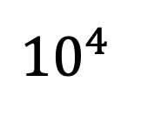
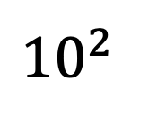

NPA
NPA without $k$-core
$${10}^{4}$$
Running time (sec)
$${10}^{2}$$
$$0$$
$$τ$$
0.2
0.4
0.6
0.8

Slide 3
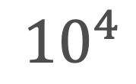
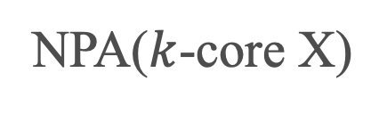
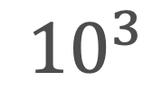
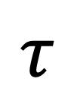
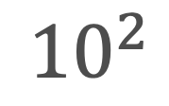
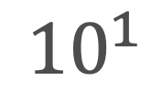
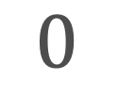
Polblogs
Brightkite
NPA
NPA($k$-core X)
$${10}^{4}$$
6
Running time (sec)
$${10}^{3}$$
4
$${10}^{2}$$
2
$${10}^{1}$$
0
$$0$$
$$τ$$
0.2
0.4
0.6
0.8
0.2
0.4
0.6
0.8

Slide 4
10000
1000
100
10
1
0.2
0.4
0.6
0.8

Slide 5

30
NPA
Ground-truth
20
Node size
10
0
0.2
0.4
$$τ$$
0.6
0.8

